Slide 1
SDL PROJECT

Slide 2
TOPIC: CLUSTER ANALYSIS
Group Members:
Niranjan Patil
Mehul Patil
Pranay Patil
Prajwal Warad

Slide 3
Introduction
Cluster analysis is the task of grouping a set of objects in such a way that objects in the same group are more similar to each other than to those in other groups.
Cluster analysis is a powerful toolkit in the data science workbench.
Cluster analysis seeks to find groups of observations that are similar to one another, but the identified groups are different from each other.

Slide 4
Literature Survey
US statistician Bernie Harris’s contribution to cluster analysis in the field of risk analysis section has benefits that are mainly meant for national security.
Dr. Bender in the year 2005 applied cluster analysis on patients. The tools he used to cluster are profile of mood states, menopausal quality of life scale, functional assessment of cancer therapy.
Again in the year 2005 Redner used cluster analysis on analysis of covariance.

Slide 5
Data Set
1. Employee Payroll:
We have the list of names of employees, their occupation and their salary. So we have applied hierarchical clustering to create clusters based on similar occupation and similar payroll. We have used four attributes here.
No: of attribute used – 3,
Attributes: Field, year and salary

Slide 6
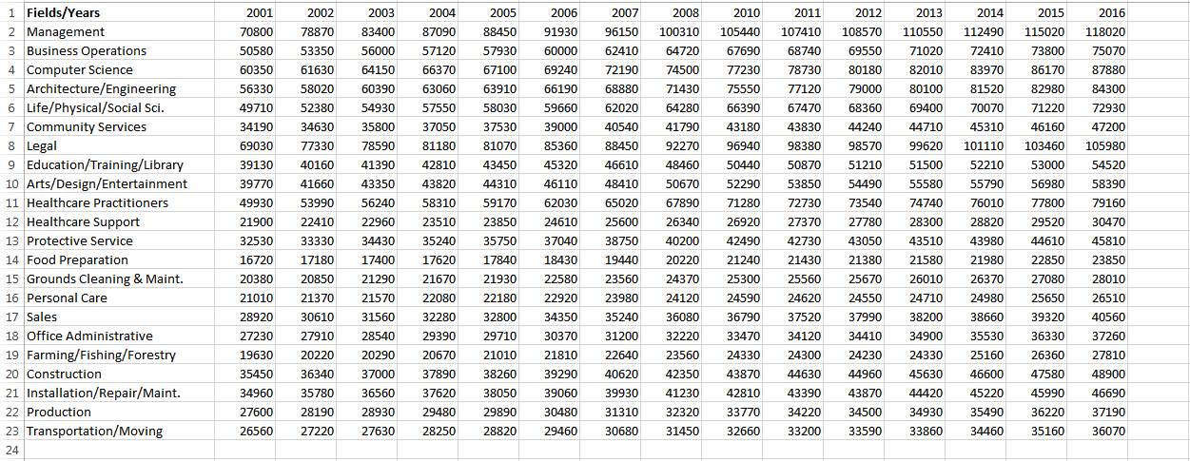
Data Set
Data from the Occupational Employment Statistics (OES) program which produces
employment and wage estimates annually. This data contains the yearly average income
from 2001 to 2016 for 22 occupation groups.

Slide 7
Data Set
2. Iris flower dataset:
Here we have list of flower species and their characteristics like petal length, sepal length and width etc. So using hierarchical clustering we have clustered them to clusters based on which specie they belong to. We have used four attributes here as well.
No: of attribute used – 5,
Attributes: Sepal length, Sepal width, Petal length, Petal Width and species

Slide 8
Functionality of the project
Scaling of two observation.
Calculating distance between observations.
Finding the closest observation to the pair.
Comparing two or more observations.

Slide 9
Expected Analysis
Dataset 1-
We use hierarchical clustering method to analyze the data and cluster the occupations that maintained similar income trends.
Dataset 2-
We use hierarchical clustering method to analyze the data and identified cluster of species

Slide 10
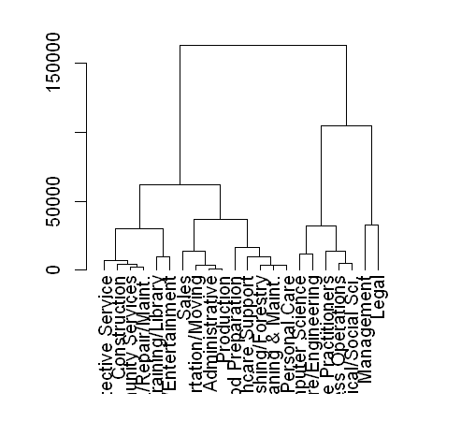
Fig. Dendogram

